Slide 1


Snehan Gorain

Slide 2
The Beginning of Monsanto

Slide 3
1901
Founded by John Francis Queeney
Began producing saccharine

Slide 4
1945
Production and marketing of agricultural chemicals begin
Aspirin
Acetylsalicyclic acid
Polychlorinated biphenyls (PCBs)

Slide 5
1960s
Ramrod herbicide is introduced
Commercialization of Lasso herbicide in the United States

Slide 6
1970s
A cell biology research program is established
Roundup herbicide is commercialized

Slide 7
1980s
Biotechnology becomes the strategic research focus
Becomes the first company to genetically modify a plant cell
Aquires Jacob Hartz See Co.
Produces aspartame for coke

Slide 8
1990s
Posilac, Bovine Somatropin, Monsanto’s first biotechnology product goes for sale
Acquires biotechnology assets of Agracetus
Acquires Calgene
Roundup Ready soybeans are introduced
Bollgard insect-protected is introduced

Slide 9
YieldGard Corn Borer insect protected corn is introduced
Asgrow Agronomics, Holden’s Foundation Seeds L.L.C and Corn States Hybrid Service are acquired
Roundup Ready Canola is introduced
Roundup Ready Cotton is introduced

Slide 10
YieldGard Corn Borer insect protected corn is introduced
Asgrow Agronomics, Holden’s Foundation Seeds L.L.C and Corn States Hybrid Service are acquired
Roundup Ready Canola is introduced
Roundup Ready Cotton is introduced
Enters into a merger and is renamed Pharmacia Corporation

Slide 11
2000 Year of the New Monsanto

Slide 12
The new Monsanto
Incorporated as a subsidiary of Pharmacia as a Pharmaceutical company
Roundup Ready Corn 2 is introduced
Seperates from Pharmacia
Begins to identify and market specific corn hybrids which yield more ethanol

Slide 13
Product Expansion
Today, Monsanto offers a wide variety of corn, cotton, soybean, wheat, canola and sugarcane seeds

Slide 14

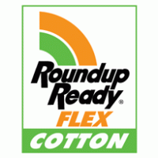
Products
YieldGard Rootworm insect-protected
Bollgard ii insect protected cotton
YieldGard Plus corn
Roundup Ready Flex cotton
Roundup Ready Corn ii technology is planted on more than 32 acres (2006)
Vistice low-linoleic soybeans

Slide 15

Dr John Franz discovers glyphosphate
Acceleron brand seed treatments

Slide 16
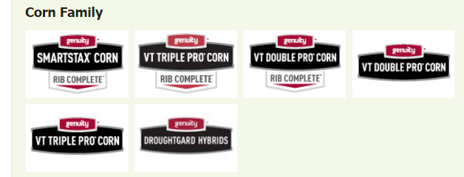
Genuity

Slide 17
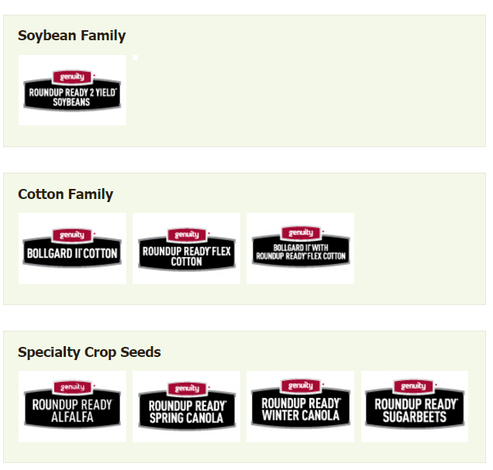

Slide 18
Subsidiaries
Channel Bio Corp and its three seed brands Crows Hybrid Corn, Midwest Seed Genetics and Wilson Seeds
Seminis
Stoneville cotton business and NC + Hybrids Inc
Delta and Pine Land Company
Aly Participacoes Ltda.
Various seed companies including Stewart Seeds, Trelay Seeds and Stone seeds

Slide 19
Subsidiaries
Aunt Jemima
Aurora Foods
Banquet
Best Foods
Betty Crocker
Bisquick
Cadbury
Campell
Capri Sin
Carnation
Coca Cola
ConAgra
Delicious Brand Cookies
Duncan Hines
Famous Amos
Frito Lay
General Mills
Heinz
Hellmans
Hershey’s Nestle
Hungry Jack
Jiffy
Kelloggs
Kid Cuisine
Knorr
Kool-Aid
Karf/Phillip Morris
Minute Maid
Nabisco
Morningstar
Nature Valley
Pasta-Roni
Pepsi
Quaker
Unilever
Totinos
Tombstone Pizza
Ore-Ida
Lipton
Interstate Bakeries
Pringles

Slide 20
GMO Foods have many Health Consequences
Organ damage
Gastrointestinal and immune system damage
Accelerated aging
Infertility
Genes inserted in GM soy can transfer to bacteria in humans, causing long term damage

Slide 21
GMOs allow for greatly increased herbicide use. Roundup is linked with
Sterility
Hormone disruption
Birth defects
Cancer

Slide 22

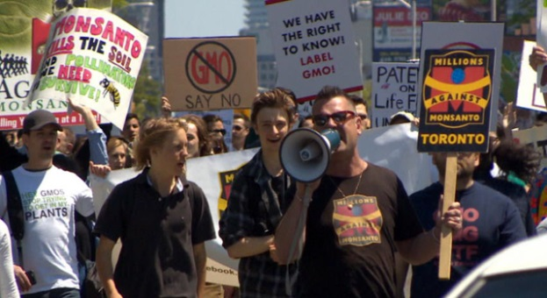

Slide 23
Further Information
https://www.organicconsumers.org/campaigns/millions-against-monsanto
http://www.globalresearch.ca/the-complete-history-of-monsanto-the-worlds-most-evil-corporation/5387964
http://www.monsanto.com/whoweare/pages/monsanto-history.aspx
http://www.monsanto.ca/products/Pages/default.aspx
http://www.foodandwaterwatch.org/insight/monsantos-seed-company-subsidiaries
http://www.monsanto.com/glyphosate/pages/default.aspx
http://responsibletechnology.org/10-reasons-to-avoid-gmos/

